Slide 1


Green Pace
Security Policy Presentation
Developer: Diego Bez Zambiazzi

Slide 2

OVERVIEW: DEFENSE IN DEPTH

Slide 3
THREATS MATRIX
Likely STD-003-CPP, STD-004-CPP, STD-005-CPP, STD-007-CPP, STD-008-CPP, STD-009-CPP | Priority STD-003-CPP, STD-004-CPP, STD-005-CPP, STD-008-CPP, STD-009-CPP,
Low priority STD-001-CPP, STD-002-CPP, STD-006-CPP, STD-007-CPP, STD-010-CPP | Unlikely STD-001-CPP, STD-002-CPP, STD-006-CPP, STD-010-CPP

Slide 4
10 PRINCIPLES
1. Validate Input Data (STD-002-CPP, STD-004-CPP, STD-010-CPP)
2. Heed Compiler Warnings (STD-001-CPP, STD-005-CPP, STD-007-CPP, STD-008-CPP, STD-009-CPP)
3. Architect and Design for Security Policies
4. Keep It Simple (STD-003-CPP, STD-007-CPP, STD-008-CPP)
5. Default Deny
6. Adhere to the Principle of Least Privilege
7. Sanitize Data Sent to Other Systems (STD-004-CPP)
8. Practice Defense in Depth (STD-004-CPP)
9. Use Effective Quality Assurance Techniques (STD-006-CPP, STD-010-CPP)
10. Adopt a Secure Coding Standard (STD-001-CPP, STD-002-CPP, STD-003-CPP, STD-005-CPP, STD-007-CPP, STD-008-CPP, STD-009-CPP, STD-010-CPP)

Slide 5
CODING STANDARDS
STD-004-CPP Sanitize query strings to prevent SQL injection using “’ or 1=1” approach
STD-003-CPP Guarantee that storage for strings has sufficient space for character data and the null terminator
STD-005-CPP Do not access freed memory
STD-009-CPP Do not read uninitialized memory
STD-008-CPP Value-returning functions must return a value from all exit paths
STD-010-CPP Detect errors when converting a string to a number
STD-002-CPP Do not cast to an out-of-range enumeration value
STD-007-CPP Handle all exceptions
STD-006-CPP Expressions used in assertions must not produce side effects
STD-001-CPP Never qualify a reference type with const or volatile

Slide 6
ENCRYPTION POLICIES
Encryption at rest
User passwords must be encrypted
Encryption keys must be stored in safe locations
Encryption in flight
Use secure protocols (SSL, HTTPS) for communication across computer networks
Use encryption tunnels (VPN) to connect to the company’s network
Encryption in use
Use confidential computing for running applications that process sensitive information

Slide 7
TRIPLE-A POLICIES
Authentication
Enforce unique usernames and strong passwords
Require passwords to be changed often
Authorization
Default Deny access and operations
Accounting
Generate log reports
Monitor user activity

Slide 8
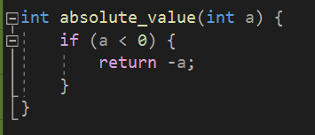
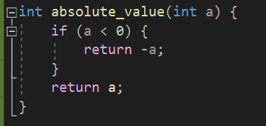
Unit Testing
STD-008-CPP: Value-returning functions must return a value from all exit paths.
Noncompliant Code: Compliant Code:

Slide 9
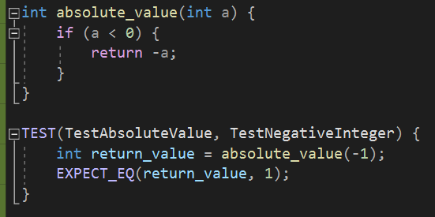
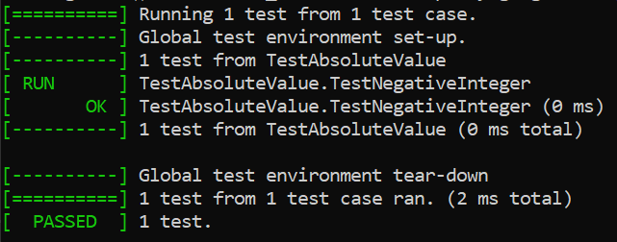
TestNegativeInteger
Noncompliant Code passes:

Slide 10
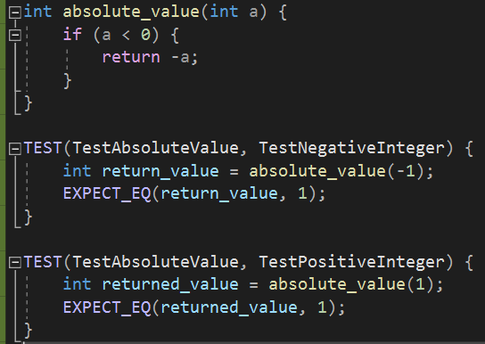
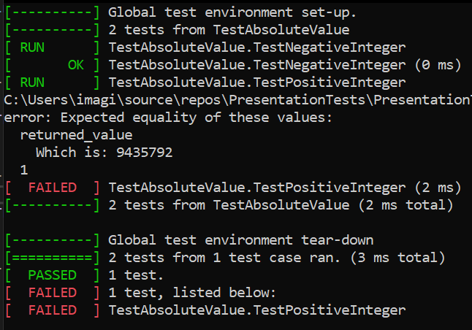
TestPositiveInteger
Noncompliant Code does not pass:

Slide 11
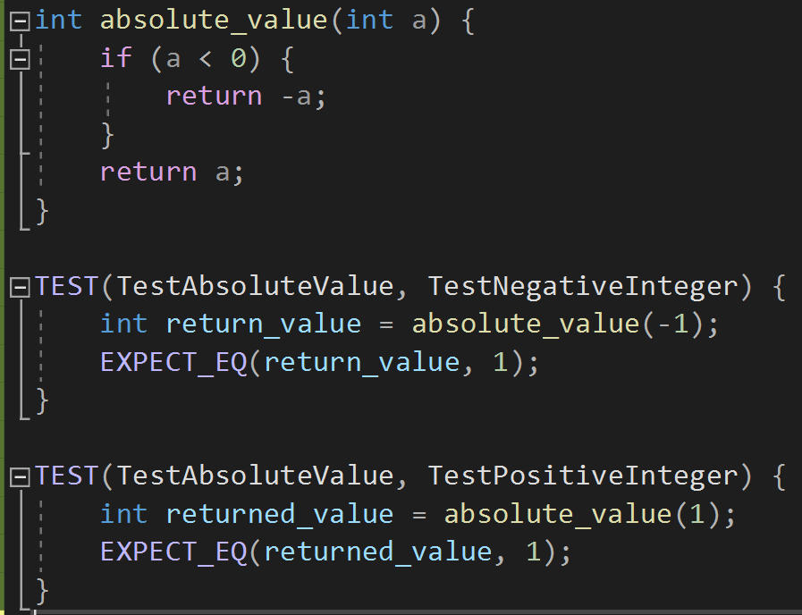
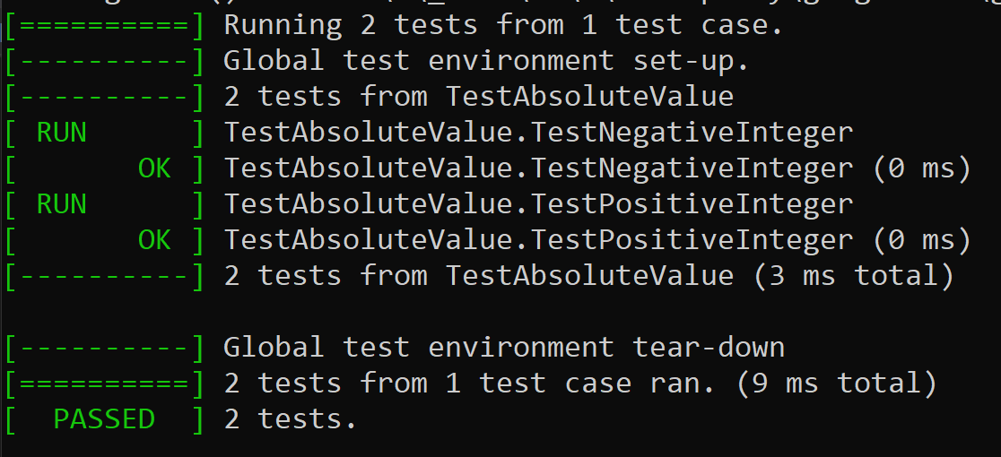
TestPositiveInteger
Compliant Code passes:

Slide 12
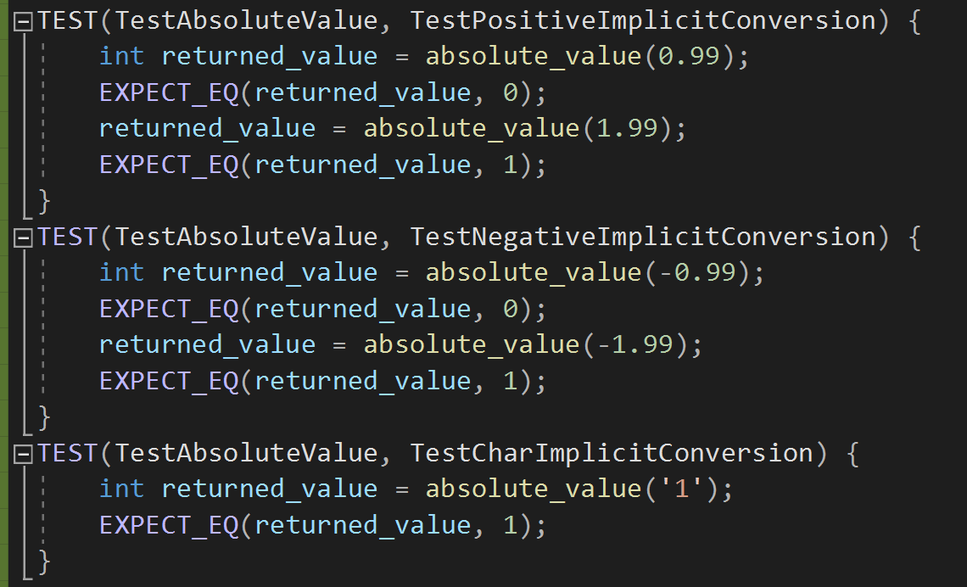
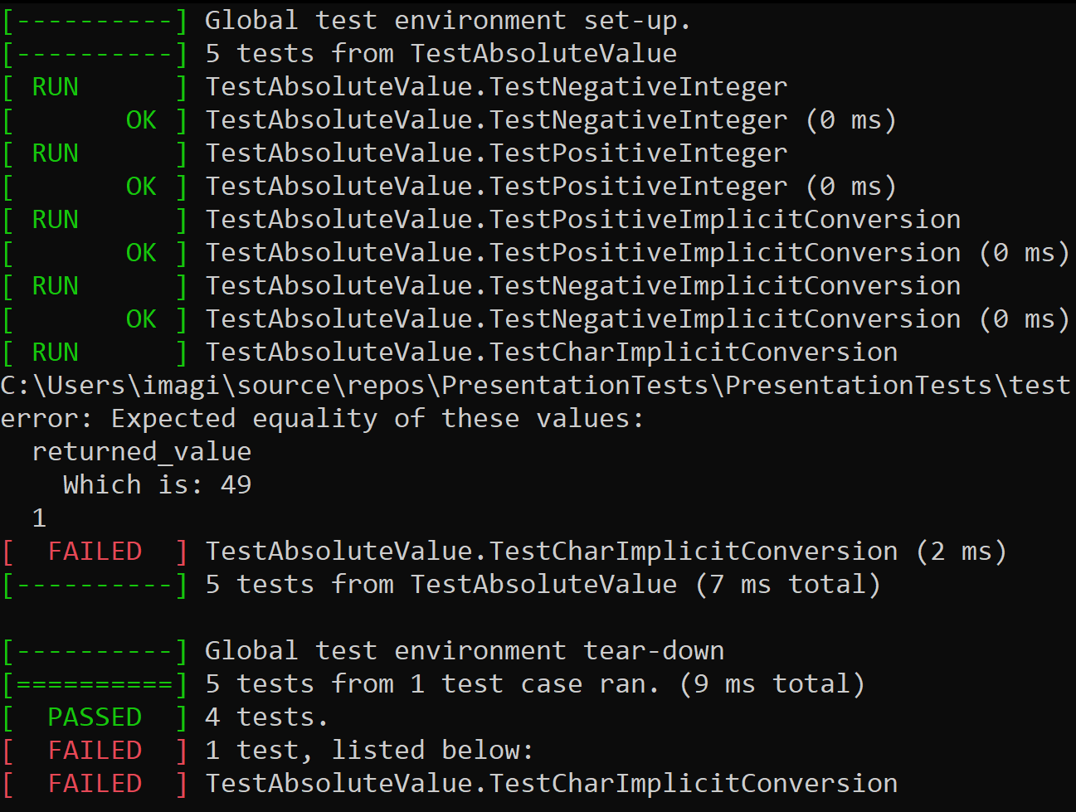
Test Implicit Type Conversion
Unit testing helps to understand behavior:

Slide 13

AUTOMATION SUMMARY

Slide 14
TOOLS
Pre-production:
Assess and Plan: Threat Modeling (Microsoft Threat Modeling Tool)
Design: Unit Testing and Mocking (Google Test)
Build: Compile build checks
Verify and Test: Static Application Security Testing (Cppcheck, Parasoft C++test)
Production:
Transition and Health Check: Deployment Health Checks (Kubernetes, AWS)
Monitor and Detect: Runtime Application Self-Protection (Imperva, AWS Services)
Respond: Automated Incident Response (LogRhythm’s RespondX, AT&T’s USM Anywhere, AWS)
Maintain and Stabilize: Assess and return to stable state (Atlassian’s Opsgenie and Bitbucket)

Slide 15
RISKS AND BENEFITS
Act Now
High Priority Standards
Encryption
Triple A
Automation
Benefits
Higher level of protection
Mitigate attacks and their consequences
Risks
Low Priority Standards
Unknown Threats

Slide 16
RECOMMENDATIONS
Invest in Defense-in-Depth
Physical, Technical, and Administrative
Insider Threats
Consider motives behind attacks
Define specific ways to respond
Real-world example: Colonial Pipeline attack in May 2021

Slide 17
CONCLUSIONS
Continuous Assessments
Threats
Automation Tools
Third-Party Verification
80% of the code in today’s applications come from libraries and frameworks (Bird, 2016)
Real-world example: ParkMobile attack in March 2021

Slide 18
REFERENCES
Bird, J. (2016, June). Chapter 4. Security as Code: Security Tools and Practices in Continuous Delivery. O’Reilly. Retrieved on August 14, 2021, from https://www.oreilly.com/library/view/devopssec/9781491971413/ch04.html
Gast, K. (2020, October 8). Top 5 Reasons to Invest in an Automated Incident Response System. LogRhythm. Retrieved on August 14, 2021, from https://logrhythm.com/blog/top-5-reasons-to-invest-in-automated-incident-response/
Kisielius, J. (2020, March 17). Automated Incident Response Explained. AT&T. Retrieved on August 14, 2021, from https://cybersecurity.att.com/blogs/security-essentials/automated-incident-response-in-action-7-killer-use-cases
Osborne, C. (2021, May 13). Colonial Pipeline attack: Everything you need to know. ZDNet. Retrieved from https://www.zdnet.com/article/colonial-pipeline-ransomware-attack-everything-you-need-to-know/
Update: Security Notification - March 2021. (2021, Mar 26). ParkMobile. Retrieved from https://support.parkmobile.io/hc/en-us/articles/360058639032-Update-Security-Notification-March-2021

